Slide 1
Classic Metaphase Client Overview
______________________________
What Is the Classic Metaphase Client?
The classic Metaphase client provides a graphical user interface (GUI) that enables PCs (using Windows 95, Windows 98, or Windows NT) or UNIX systems to interact with Metaphase servers. It supplies the browser and dialog windows that allow you to view and locate database data and operating system files in the directories that you register with Metaphase.

Slide 2
Software Hardware & Disk Space Requirements
Platform Operating System
DIGITAL Alpha Microsoft Windows NT 4.0 SP3
Windows NT
DIGITAL UNIX DIGITAL UNIX 4.0A
Hewlett-Packard HP-UX HP-UX 10.20
IBM AIX AIX 4.2.0.0
Intel (486 and Pentium) One of the following:
Microsoft Windows Windows 95
Windows 98
Windows NT 4.0 SP3

Slide 3
Minimum Configuration Requirements
Operating System Minimum Requirements
Windows 95, 98, NT 486 processor (Pentium processor recommended)
16 megabytes of memory (24 megabytes or more recommended) in addition to the disk space required by the operating system and other installed applications.
15 megabytes of free disk space
640 x 480 monitor (1024 x 768 or higher resolution monitor recommended)

Slide 4
Installing the Classic Metaphase
Client on a Windows Host
-----------------------------------------------------------------------------------
This chapter describes how to install the classic Metaphase client on an Intel (486 and Pentium) Microsoft Windows 95, 98, or NT host.1
-----------------------------------------------------------------------------------
The tasks in this chapter are:
Installing the classic Metaphase client.
Updating the autoexec.bat file and restarting the PC.
Checking the Metaphase server hosts.
Starting the network and services.
Starting and stopping the classic Metaphase client.
Installing the Metaphase online documentation.
.

Slide 5
Selecting a Setup Type
Setup Type Description
Typical Installs all the classic Metaphase client components and configures the PC. This requires 15 megabytes of disk space.
File Server Installs the software on a file server machine. This establishes a shared Metaphase client location that other PCs can access.
You must also perform a Workstation Configuration installation on each PC that runs the software installed on the file server machine.

Slide 6
Selecting a Setup Type
Setup Type Description
Workstation Configuration Configures a PC to run Metaphase client software that is already installed on a file server machine.
Windows must be installed locally, or a network-shared copy must have separate, writable Windows directories for each user’s .ini and .grp files.
Before running the Workstation Configuration installation, the shared Metaphase client location (created with a File Server installation) must be accessible using a path that begins with a drive letter (not backslash characters).

Slide 7
Gathering Configuration Information
Before you begin a Typical or Workstation Configuration setup, ask your Metaphase administrator for these values, which the installation program asks you to provide:
The Host Name of your PC.
The Network Communications protocol used to
communicate with the Metaphase server, either TCP/IP or
NetBIOS.
The Metaphase Server Host Name.
This is a Metaphase server host that provides services to the machine that runs the classic Metaphase client.
For TCP/IP, the Network IP Port.
The value you supply must match the value of the VC_MUX_IPPORT configuration variable that is set in the Configuration Editor (and which, by default, is 7031).

Slide 8
Step 1:
Install the Classic Metaphase Client
Use the following procedure to install the classic Metaphase client:
1. Place the Metaphase 3.1 CD-ROM into a CD-ROM drive that is either attached to your PC or is accessible from a PC network.
The CD-ROM images of the classic Metaphase client are in the nt_intel\winclnt\omf_clnt directory.
2. Click Start and choose Run. Windows displays the Run window.
3. Enter the installation drive letter and the setup command in the Open field and click OK. For example, if you install from drive e, enter this command:
e:\nt_intel\winclnt\omf_clnt\setup
The installation program displays the OMF Client Installation dialog window.

Slide 9
4. Continue by entering information in the dialog windows that the
installation program presents.
The installation program windows include Next and Back buttons that
allow you to page through the dialog windows and check your responses
to prompts. You can also click Help to see more detailed information.
Based on the configuration information you provide, the installation program creates the configuration files listed below. (The files are listed at the default locations.)
NOTE
If you reinstall the classic Metaphase client to the same directory, the installation program backs up your old config.cfg, pdmsetup.bat, dynatext.ini, and mti.ini files to config.old, pdmsetup.old, dynatext.old, and mti.old.

Slide 10
c:\Program Files\Metaphase Enterprise 3.1\config.cfg
Contains the configuration information to allow connections to remote computers.
c:\Program Files\Metaphase Enterprise 3.1\pdmsetup.bat Contains the environment variables needed for executing the classic Metaphase client.
c:\winnt\dynatext.ini
On Windows NT, contains the paths to the Metaphase online documentation and resources for the online documentation browser.
c:\windows\dynatext.ini
On Windows 95 or Windows 98, contains the paths to the Metaphase online documentation and resources for the online documentation browser.
c:\winnt\mti.ini
On Windows NT, contains initialization variables for the classic Metaphase client browser.
c:\windows\mti.ini
Contains initialization variables for the classic Metaphase client browser.

Slide 11
Step 2:
Update the autoexec.bat File and Restart the PC
Edit your autoexec.bat file and restart your computer as described in the following steps:
1. On a Windows 95 or Windows 98 system (not a Windows NT system),
add a line to the autoexec.bat file to call the pdmsetup.bat file
produced by the installation program. Do not use long file names in this
statement. For example, if your pdmsetup.bat file is in the
c:\Program Files\Metaphase Enterprise 3.1 directory, add the following
line:
CALL C:\Progra~1\Metaph~1.1\pdmsetup.bat
Because the pdmsetup file updates your PATH statement, place the call statement after the set path statement (if the file includes one).

Slide 12
2. Optionally, create the Metaphase TMP environment variable in your
autoexec.bat file.
The TMP environment variable specifies a directory to contain the temporary files occasionally created by Metaphase execution. If you do not create a TMP
environment variable, Metaphase places these files in your PC root directory.
Create the TMP environment variable in one of the following ways:
To use the same directory as the Windows TEMP variable, add the
following line after the Windows SET TEMP line:
SET TMP=%TEMP%
To use a different directory, create a directory for the temporary files and
then set the TMP variable in your autoexec.bat file. For example, if the
temporary file directory is c:\tmp, you would add the following line:
SET TMP=C:\TMP
You can perform this step on a Windows 95, Windows 98, or Windows NT system.
3. Restart your PC.

Slide 13
Step 3:
Check the Metaphase Server Hosts
The classic Metaphase client requires access to a Metaphase server on one of your server hosts. Before you can run the classic Metaphase client, your Metaphase administrator must update the Metaphase configuration on the server so that it is aware of your PC. Your administrator must:
Use the Configuration Editor (which runs on the Metaphase corporate
server) to add your PC to the Metaphase environment.
Move files that the Configuration Editor creates (files that contain
your host definitions) to any local area or work group servers that
serve your PC.
Stop and restart the MUX, dispatcher, and object servers on the hosts that
serve your PC, so they have the updated configuration.

Slide 14
Steps to Modify Host Information
Step I:
Go to $MTI_ROOT/Install directory
Run the command cfgedit
The Metaphase Configuration Editor Screen appears as shown in the following slide.

Slide 15
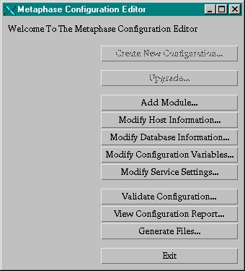

Slide 16
Steps to Modify Host Information
Step II:
Click on the Button :
Modify Host Information
The screen of Modify Host Information
appears as shown in the next slide.

Slide 17
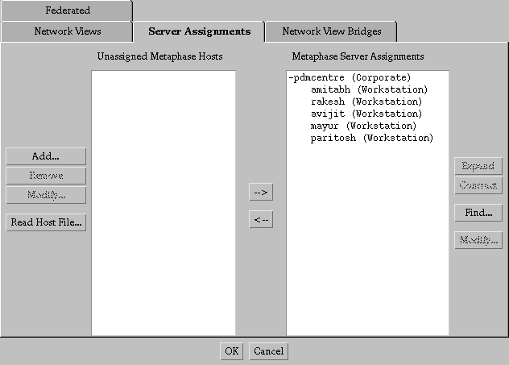

Slide 18
Steps to Modify Host Information
Step III:
Click on the Button :
Add...
The screen of Add Metaphase Host
appears as shown in the next slide.

Slide 19
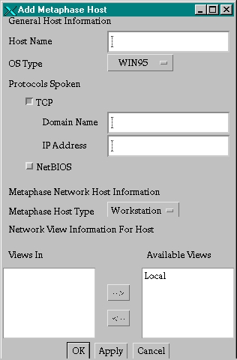

Slide 20
Steps to Modify Host Information
Step IV :
Against the Host Name field add the name of a valid host eg: John
Against the Domain Name field add the name of the valid Domain name
eg: pdmcentre
Against the IP Address field add the IP Address of the Domain Name mentioned above eg: 10.11.30.65
Against the Available Views field click on the word Local & then press the Lower Arrow to move Local from below Available Views to Views In field.
Then finally press OK Button.

Slide 21
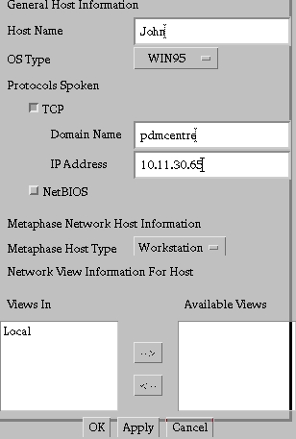

Slide 22
Steps to Modify Host Information
Step V :
After pressing the OK button you return back to the previous screen of Modify Host Information .
Notice the addition of the host under the heading Unassigned Metaphase Hosts.
Also notice the column Metaphase Server Assignments as shown in the next slide.

Slide 23


Slide 24
Steps to Modify Host Information
Step VI :
Select John(Workstation) from under the Unassigned Metaphase Hosts list and also simultaneously select pdmcentre(Corporate) from the Metaphase Server Assignments list so that both are highlighted at the same time.
Then press the arrow pointing towards right ie.towards Metaphase Server Assignments so that the new host name is added on to the list as shown in the next two slides.

Slide 25
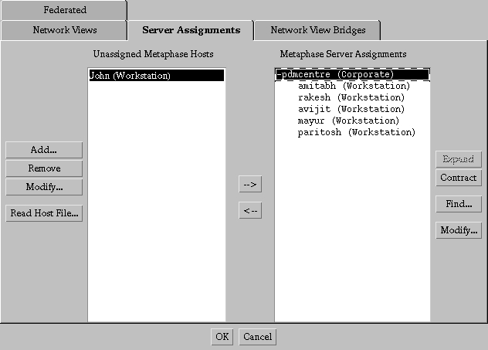

Slide 26
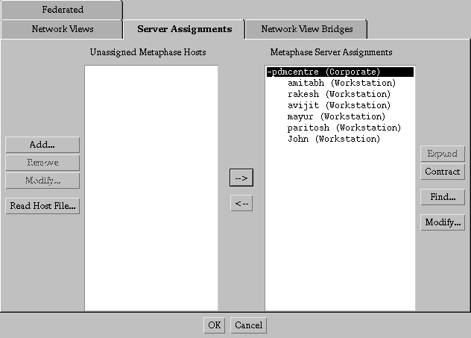

Slide 27
Steps to Modify Host Information
Step VII :
After clicking on the OK button then you will return back to the Metaphase Configuration Editor.
This is the same screen with which you earlier started with.
Now on this screen press the Generate Files... Button to obtain the following screen.

Slide 28
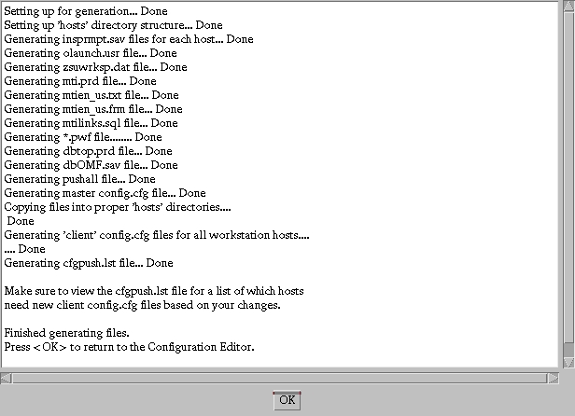

Slide 29
Steps to Modify Host Information
Step VIII :
After clicking on the OK button then you will return back to the Metaphase Configuration Editor.
This is the same screen with which you earlier started with.
Now on this screen press Exit button to come out the screen.

Slide 30
Steps to Modify Host Information
Step IX :
Of the many files generated note these two files:
1) $MTI_ROOT/install/hosts/John/config.cfg
2) $MTI_ROOT/install/site.cfg
Copy both these files to any local area or workgroup servers that serve your PC.

Slide 31
Step 4:
Start the Network and Services
Use the following procedure to start the network:
1. Click Start and choose the following options:
Program → Metaphase Client→ Network Startup
When the network is running, the OMF Network icon is visible in the taskbar.

Slide 32
2. To verify that the network is running and that the
configuration information was downloaded from the server,
perform the following steps:
a. Click Start and choose the following options:
Programs→Metaphase Support→Network Ping Config Host
The network ping checks the status of the server host to
determine whether communications are established.
b. Click Start and choose the following options:
Programs→Metaphase Support→ Network Ping Output
A Notepad window shows the output from network ping. If the
ping is successful, the report indicates the number of bytes
received from the server host and the round trip time in
milliseconds.
c. Close the Notepad window.

Slide 33
Use the following procedure to start the services dispatcher:
1. Click Start and choose the following options:
Programs→ Metaphase Client →Services Startup
When the services dispatcher is running, the Services icon is
visible in the taskbar.

Slide 34
2. To verify that the services status program is running, perform
the following steps:
a. Click Start and choose the following options:
Programs→Metaphase Support →Services Status
b. Click Start and choose the following options:
Programs → Metaphase Support→ Services Status Output
A Notepad window displays the OS_SERV status report.
Because you recently started the network and services, the
number displayed is 0, which is normal.
NOTE :
Whenever you use Metaphase to perform file operations (for example, transferring, deleting, or opening files), the services status should indicate that OS_SERV is running.
c. Close the Notepad window.

Slide 35
Step 5:
Start and Stop the Classic Metaphase Client
Use the following procedure to start the classic Metaphase client:
1. Click Start and choose the following options:
Programs→Metaphase Client→ Classic Client
Metaphase displays the Metaphase Login dialog window.
NOTE
Starting the classic Metaphase client the first time takes longer than subsequent startups. The initial startup downloads and caches files and additional information on your PC to accelerate later sessions.

Slide 36
2. Enter your assigned Metaphase user name and password.
Metaphase displays your home browser.
3. Optionally, to automatically start the classic Metaphase client
network and services every time you start Windows, place the
Network Startup and Services Startup programs into the
StartUp folder.
NOTE
Depending on the resolution of your PC monitor, the classic Metaphase client browser and dialog windows may appear too big or too small. This applies both to the size of fonts and to the windows themselves. You can change the default settings by editing the mti.ini file in the directory where you installed the classic Metaphase client. For additional information about changing user interface settings, see the Object Management Framework User’s Guide.

Slide 37
To stop the classic Metaphase client, use the following procedure:
1. Exit OMF (pull down the File menu and choose Exit).
2. Select the OMF Services icon, click to display the system menu, and choose Close.
3. Select the OMF Network icon, click to display the system menu, and choose Close.

Slide 38
Step 6:
Install the Metaphase Online Documentation
Installing Documentation for the First Time
This section describes how to install the online documentation
for the first time. If you have an earlier version installed, see
Upgrading Online Documentation, next in this chapter.
Install the online documentation as follows:
1. Place the Metaphase 3.1 CD-ROM into a CD-ROM drive that
is either attached to your PC or is accessible from a PC
network.

Slide 39
2. Create a directory named dtext on your PC or PC file server
hard drive.
3. Create a directory named public under dtext.
4. Copy the pcdata directory from nt_intel\winclnt\pcdata on the
CD-ROM to the dtext directory on your hard drive.
You should now have dtext\pcdata on your hard drive.
5. Copy the mtibooks directory from the CD-ROM to the dtext
directory on your hard drive.
You should now have dtext\mtibooks on your hard drive.

Slide 40
Classic Metaphase Client Program Groups and Items
This table describes the Windows program groups and items created by installing the classic Metaphase client.
--------------------------------------------------------------------------------------
Program Group Item Description/Purpose
--------------------------------------------------------------------------------------
Metaphase Client Network Starts the connection to the
Startup Metaphase network—must be started
first. By default the connection is
started with logging enabled, which
means that output is written to files
you can view using Windows
Notepad.

Slide 41
----------------------------------------------------------------------------------------
Program Group Item Description/Purpose
----------------------------------------------------------------------------------------
Services Starts the process that manages
Startup background services on your PC
(such as file transfer). By default,
the process is started with logging
enabled, which means that output
is written to files you can view
using Windows Notepad.
Object Starts the graphical user interface
Mgmt client for interactive browsers and
Framework dialogs.
DynaText Starts the Metaphase online
documentation browser.

Slide 42
----------------------------------------------------------------------------------------
Program Group Item Description/Purpose
----------------------------------------------------------------------------------------
Metaphase Support Services Stops the services management
Disconnect program. You can also stop the
services using the System menu of
an executing Services icon.
Network Stops the Metaphase network
Disconnect access program. You can also stop
the network using the System
menu of an executing Network
icon.
Network Launches Windows Notepad to
Startup view the output file from the
Output network startup program.
Services Launches Windows Notepad to
Startup view the output file from the
Output services startup program.

Slide 43
----------------------------------------------------------------------------------------
Program Group Item Description/Purpose
----------------------------------------------------------------------------------------
OMF Log Launches Windows Notepad to
Output view the log/capture file from the
classic Metaphase client. This
assumes that the log file is written
to the installation directory named
omflog.txt. The file name is specified on the command for the
Object Mgmt Framework icon
with the –cf argument. For
example:-cf c:\omf31\omflog.txt
Network Log Launches Windows Notepad to
Output view the log file from the network
access program. You cannot view
the file while the network is executing.

Slide 44
----------------------------------------------------------------------------------------
Program Group Item Description/Purpose
----------------------------------------------------------------------------------------
Services Log Launches Windows Notepad to
Output view the log file from the services
dispatching program. You cannot
view the file while the services
dispatcher is executing.
Configuration Launches Windows Notepad to edit
File the Metaphase configuration file.
Configuration Executes the configuration test
Test program to view the current
configuration. The output is written
to a text file you can view using
Windows Notepad. See also the
description of the Configuration
Test Output program item.

Slide 45
----------------------------------------------------------------------------------------
Program Group Item Description/Purpose
----------------------------------------------------------------------------------------
Configuration Launches Windows Notepad to
Test Output view the output file from the
configuration test program.
Network Status Checks the status of the Metaphase network. The result is written to a text file you can view using Windows Notepad.
Network Status Launches Windows Notepad to
Output view the output file from the
network status program.

Slide 46
----------------------------------------------------------------------------------------
Program Group Item Description/Purpose
----------------------------------------------------------------------------------------
Network Ping Performs a muxping of the
Config Host configuration host to determine if your PC network program is
connected to the configuration
server host and if the server
recognizes your PC. The output
from the operation is written to a
text file you can view using
Windows Notepad. See also the
description of the Network Ping
Output program item.
Network Ping Launches Windows Notepad to
Output view the output file from the
muxping program.

Slide 47
----------------------------------------------------------------------------------------
Program Group Item Description/Purpose
----------------------------------------------------------------------------------------
Services Checks the status of the
Status Metaphase services dispatcher.
The result is written to a text file
you can view using Windows
Notepad. See also the
description of the Services
Status Output program item.
Services Launches Windows Notepad to
Status view the output file from the
Output services status program.

